Slide 1
SOCIO ANALYZER
TEAM MI 7
Abhijeet Agarwal
Durga Charan Potukuru
Krishna Veni Karri
Praneetha Jaladanki
Srinivas Pakala
Vipul Chandoor

Slide 2
Outline
Introduction​
Problem Statement & Solution​
Tools and Technology​
Methodology​
Custom classifier ​
Limitations​
Acknowledgement

Slide 3

Client
Dr. Kyoung-Ho Shin
Professor
School of Health Science and Wellness
Northwest Missouri State University
Ph.D. Sociology
Kansas State University, 1999

Slide 4
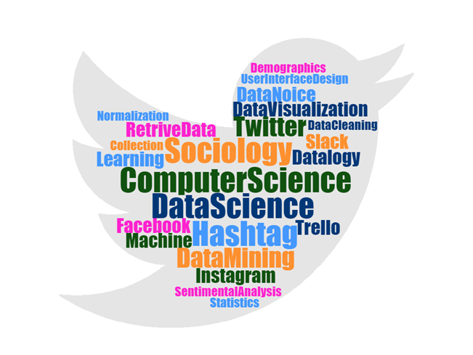
Introduction
A social issue is a problem that influences a considerable number of the individuals within a society.
Example: BlackLivesMatter, Florence, MeToo
Study of people’s reaction on different social issues
By integrating the data science with sociology, we can analyse the huge data by using Machine learning algorithms.
Vipul Chandoor
Notes:
What is total data size or number of cases for this project?
A. In this project, the data size or number of cases may depend on the data retrieved for a particular hashtag. On an average, we may have a data size of about 500-1000 records for every hashtag.
2. Define or briefly explain what is 'Machine learning algorithms.’
A. Machine learning algorithms help in analyzing data by making significant decisions where the data is trained and tested to make best possible accurate future decisions.

Slide 5
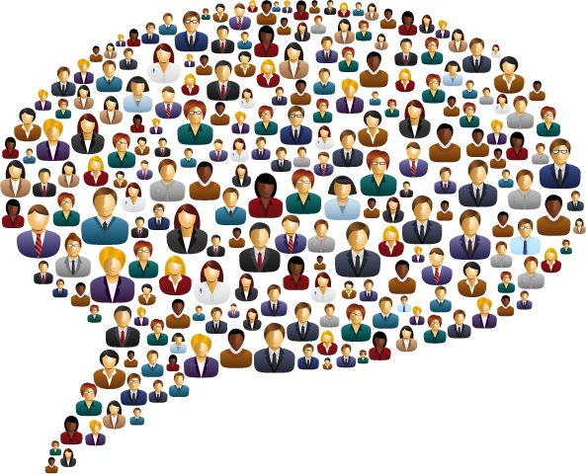


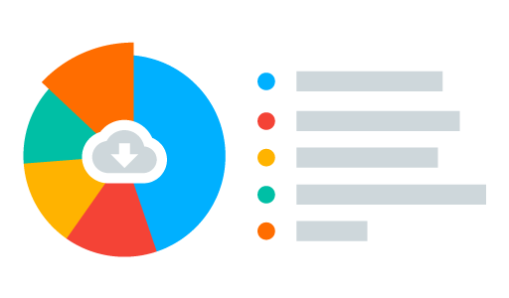
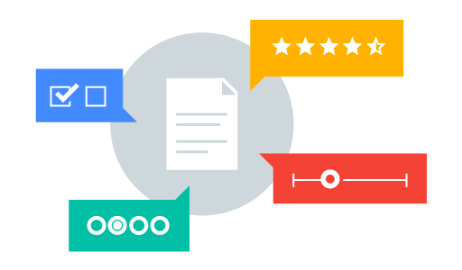
Problem statement
Interviewing
People’s opinions
Vipul Chandoor
Polls and surveys

Slide 6



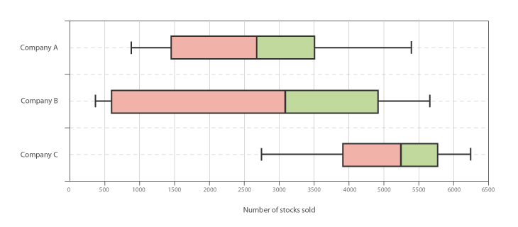
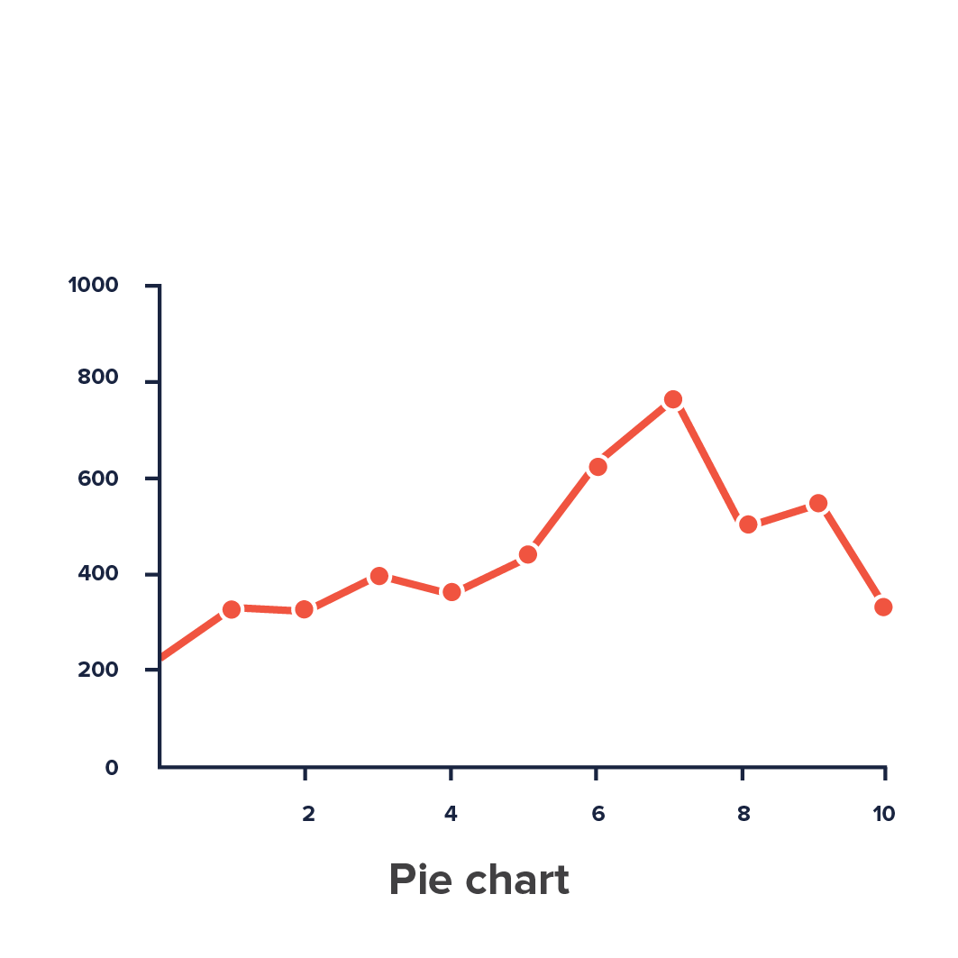
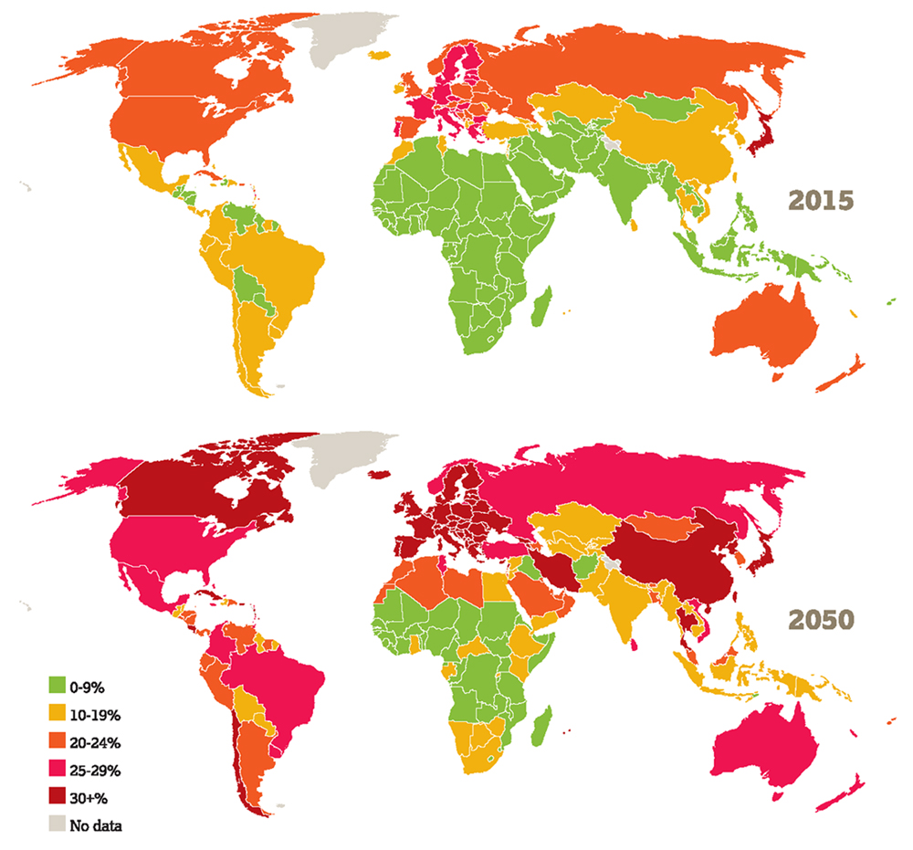
Proposed solution
Emotions
Twitter
Hashtag
Reports
Vipul Chandoor

Slide 7


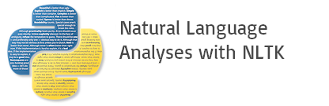


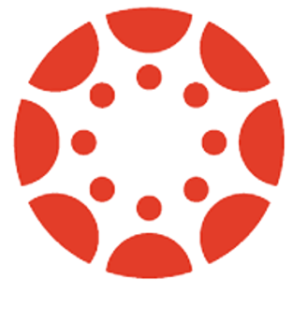
Tools and technologies
Python
Natural Language Toolkit
TextBlob
Github
Google docs
Canvas
Vipul Chandoor
Notes:
3. Are they all tools that our project (already) used?
Yes, we are using these tools in the project.
Angular: To developed a front end and user interface to help user enter a hashtag
Nodejs: Manipulates the business logic in the backend(server-side), used for data exchange
MongoDB: To store the retrieved data
Python: To develop scripts for data retrieval

Slide 8
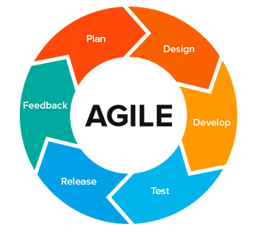
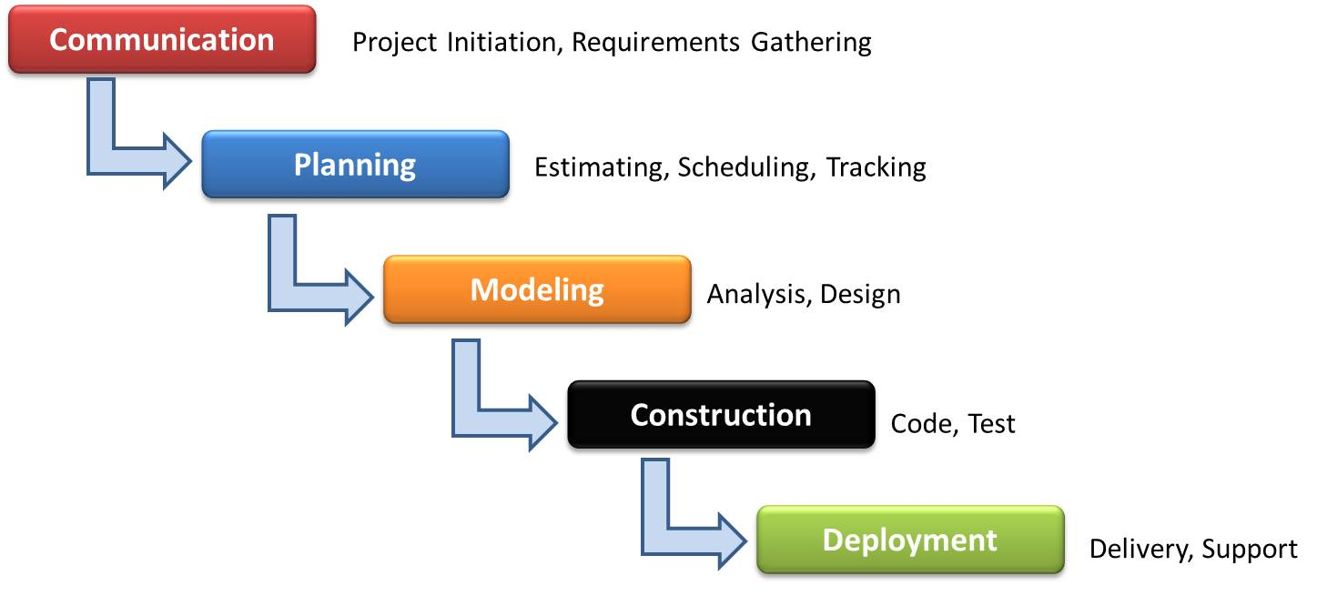
Methodology
Agile and Waterfall Methodology
Krishnaveni Karri

Slide 9
Methodology contd.
 | Data Science | Web Development
Concept | Statistics, Algorithms, Models | Creating web pages, applications for intranet in a public or private platform
Coding | Feeding the computer a set of commands | Entire process consists of coding
Languages | C/C++/C#, Java, Python, R, Stata | HTML, CSS, Javascript, JQuery, PHP, Python, Ruby
Challenges | Unavailability or difficult to access data, data security and data storage | Client requirements keep changing, need to work on site content, takes time in obtaining a final product
Krishnaveni Karri

Slide 10
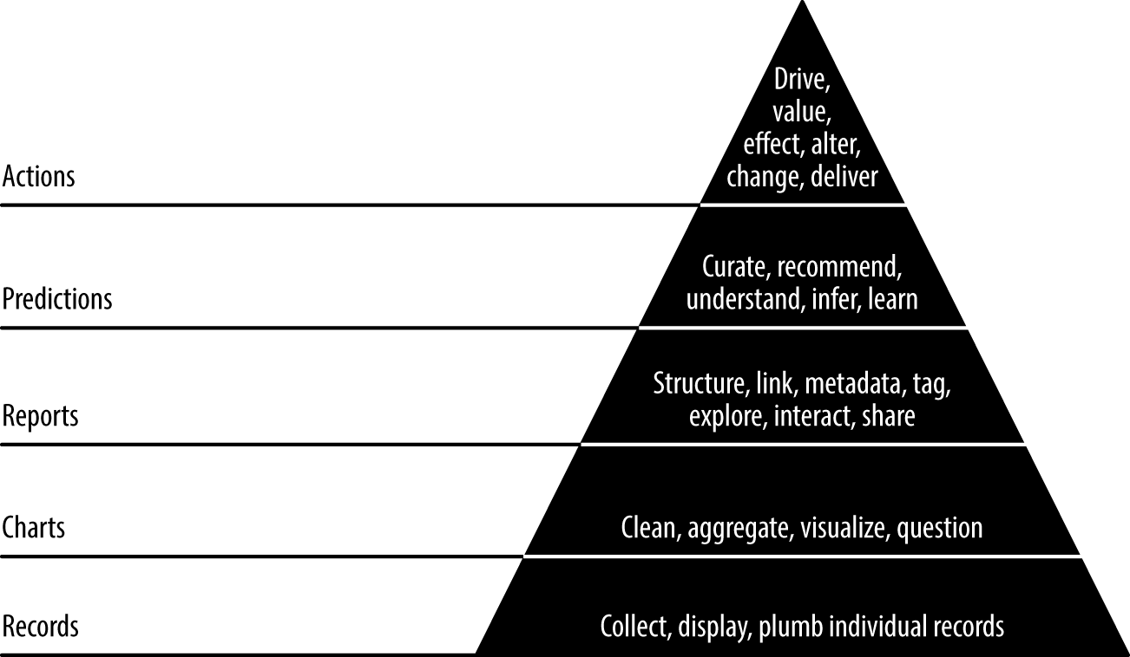
Methodology contd.
Krishnaveni Karri

Slide 11
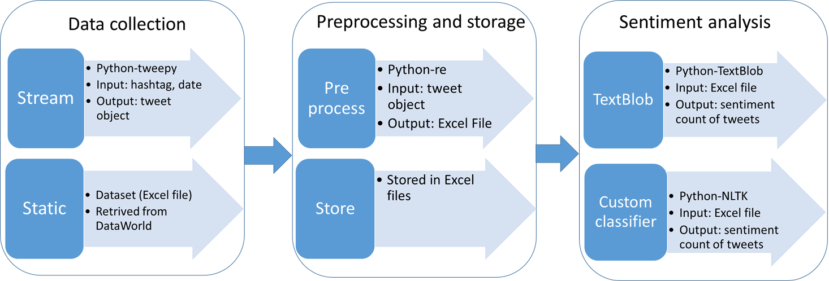
Workflow
Krishnaveni Karri

Slide 12
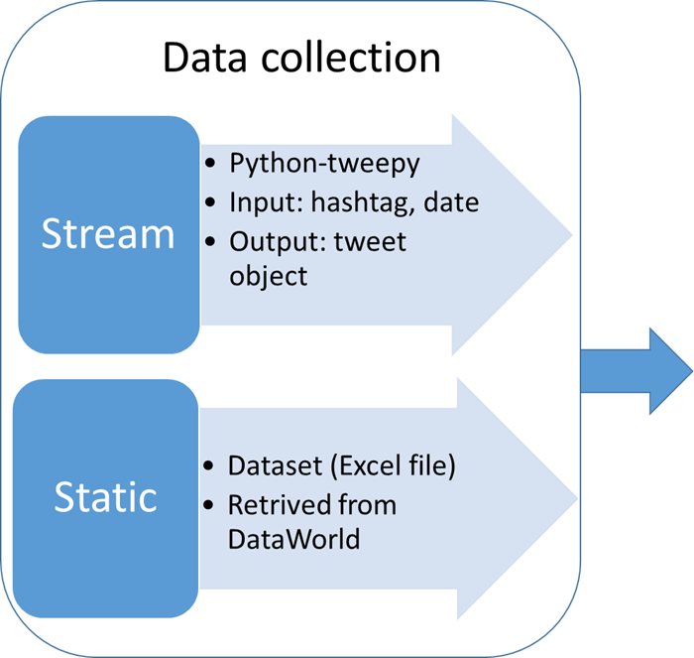
Workflow cont..
Krishnaveni Karri

Slide 13
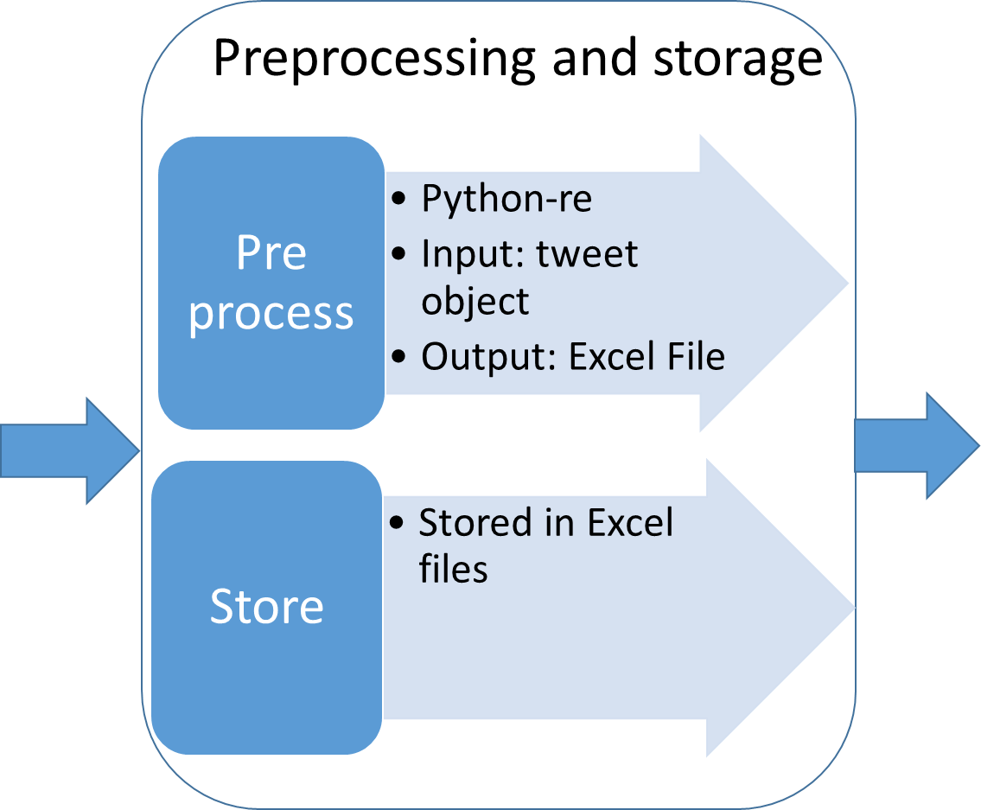
Workflow cont..
Krishnaveni Karri

Slide 14
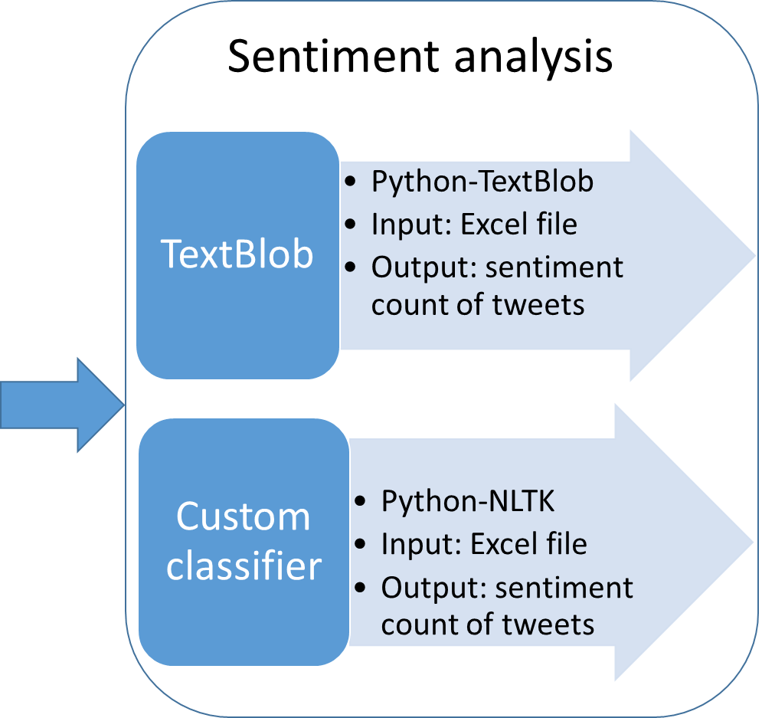
Workflow cont..
Krishnaveni Karri

Slide 15

Sentiment analysis
Third-party library
TextBlob
Custom Analyzer
Abhijeet Agarwal

Slide 16

Sentiment analysis - TextBlob
Python’s third-party library
Classify text into positive, negative and neutral.
Gives output with 2 values
Polarity – Emotion for the text
Score is a float within the range [-1.0, 1.0]
Subjectivity – Opinion respective of the topic
Float within the range [0.0, 1.0]
-1 – Negative, 0 – Neutral, 1 - Positive
Abhijeet Agarwal

Slide 17
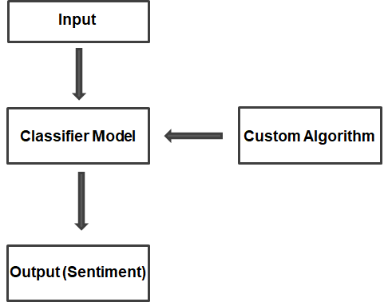
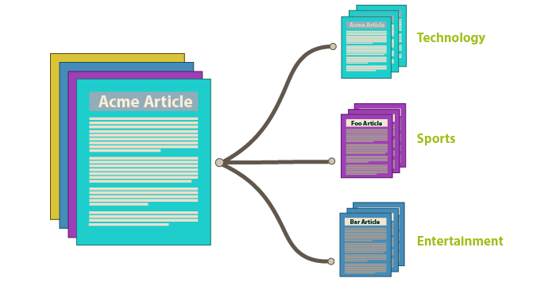
Sentiment analysis – Custom Analyzer
Positive
Negative
Neutral
Step 1: Building a Dictionary
Step 2: Text Classification
Abhijeet Agarwal

Slide 18
Step 1 : Building a dictionary
Establish a dictionary
Manual
Third-party libraries
Python package : Natural Language Toolkit
Abhijeet Agarwal

Slide 19
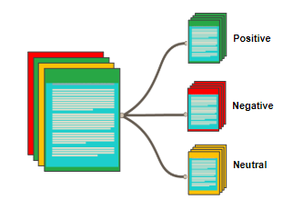
Using NLTK
['it', 'is', 'beautiful', 'day', 'to', 'go', 'for', 'fishing']
2. Tokenize
1. Input Dataset
“It is beautiful day to go for fishing”
['it', 'is', 'beautiful', 'day', 'to', 'go', 'for',
'fishing’]
['beautiful', 'day', 'go', 'fishing']
3. Remove Stop Words
5. Polarized Output
['beautiful', 'day', 'go', 'fishing’]
['beauti', 'day', 'go', 'fish']
4. Stemming
Abhijeet Agarwal

Slide 20
Step 2: Text Classification
Test data
Preprocess data
Classify the data
Output
Tokenizer,
Remove stop words,
Stemming
Using Dictionary from Step 1
Abhijeet Agarwal

Slide 21
Dataset Validation
Performed manual validation
Number of tweets : 765
Domain: Weather
Source : https://data.world/crowdflower/weather-sentiment
Benchmark dataset for our project
Number of attributes: 11
Number of attributes : 02
Praneetha Jaladanki
Notes:
Why dataset validation?

Slide 22
Validation Results
Praneetha Jaladanki

Slide 23
Project phases
Phase I
Validating manual results with TextBlob and Custom Analyzer
Calculating accuracy of Custom analyzer
Phase II
Improving dictionary
Validating test results with improvised dictionary
Improving accuracy of Custom analyzer
Praneetha Jaladanki
Notes:
Adding words to dictionary
Validation of benchmark dataset with TextBlob and Custom Analyzer
Calculating the accuracy of custom analyzer
Adding more words to the dictionary
Validation of benchmark dataset with TextBlob and Custom Analyzer
Improving accuracy of the custom analyzer

Slide 24
Phase I: Validation of dataset results
Total number of tweets - 765
Number of tweets
Praneetha Jaladanki
Notes:
Need to put percentage, value for the numbers on the graphs.
Need to animation - bar wise display

Slide 25
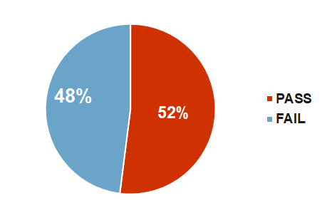
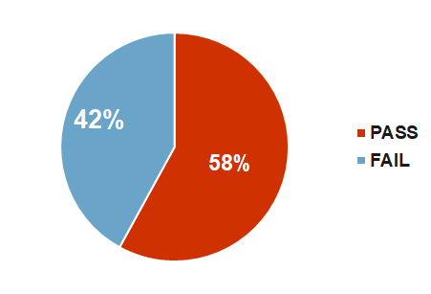
Phase I: Accuracy comparison
Custom Analyzer
TextBlob
Pass is a case when the manual result matches with Custom Analyzer and TextBlob.
Fail is a case when the manual result doesn't match with Custom Analyzer and TextBlob.
Praneetha Jaladanki
Notes:
Pass is a case where the manual result matches with custom analyzer and TextBlob.
Fail is a case when the manual result doesnt match with custom analyzer and TextBlob.

Slide 26
Phase II: Improvising the data dictionary
​ | Positive Words​ | Negative Words​ | Neutral Words​ | Total Words
Phase I | 398​ | 517 | 38644 | 39,559
Phase II | 792 | 1081 | 39709 | 41,582
New dataset source: http://ptrckprry.com/
Praneetha Jaladanki
Notes:
http://ptrckprry.com/course/ssd/data/positive-words.txt
http://ptrckprry.com/course/ssd/data/negative-words.txt

Slide 27
Phase II: Validation of dataset results
Number of tweets
Praneetha Jaladanki
Notes:
Need to make new grpah with increased dictionary count
Need to put percentage, value for the numbers on the graphs.
Need to animation - bar wise display

Slide 28
Phase II: Validation of dataset results by Custom Analyzer
Number of tweets
Praneetha Jaladanki
Notes:
Need to make new grpah with increased dictionary count
Need to put percentage, value for the numbers on the graphs.
Need to animation - bar wise display

Slide 29
Phase II: Improved accuracy
Custom Analyzer
Pass is a case when the manual result matches with Custom Analyzer
Fail is a case when the manual result doesn't match with Custom Analyzer
Praneetha Jaladanki
Notes:
Pass is a case where the manual result matches with custom analyzer and TextBlob.
Fail is a case when the manual result doesnt match with custom analyzer and TextBlob.
53%ACCURACY CHART

Slide 30
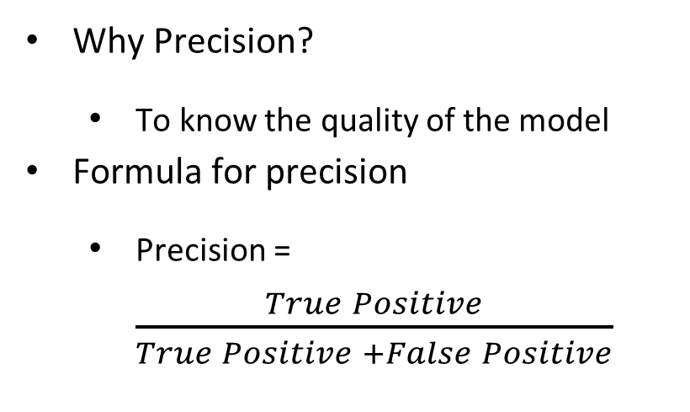
Precision
Why Precision?
To know the quality of the model
Formula for precision
Precision = $\frac{True Positive}{True Positive +False Positive}$
 |  | Predicted
 |  | Positive | Negative
Actual | Positive | True Positive | False Negative
 | Negative | False Positive | True Negative
Srinivas Pakala

Slide 31
Consideration
The results of sentimental analysis will be in
Positive
Negative
Neutral
As we can not find precision for Neutral, so we came up with 2 strategies
Neutral as Positive
Neutral as Negative
Srinivas Pakala

Slide 32
Considering Neutral tweets as Positive
 | TP | FP | Precision
Custom classifier | 428 | 177 | 0.707438
TextBlob | 447 | 166 | 0.729201
Precision of Custom Analyzer is 70.74% when we consider neutral tweets as positive tweets.
Precision of TextBlob is 72.92% when we consider neutral tweets as positive tweets.
Srinivas Pakala

Slide 33
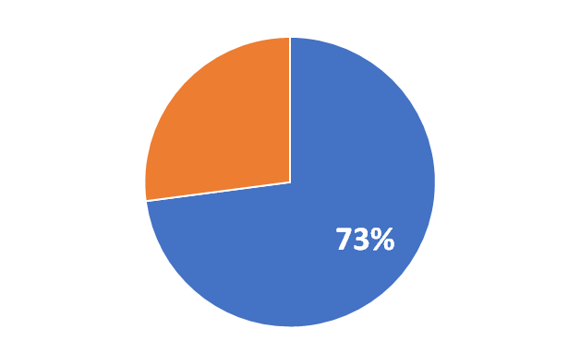
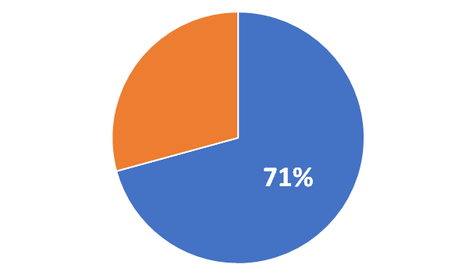
Results for considering Neutral tweets as Positive
Custom Analyzer Precision
TextBlob Precision
Srinivas Pakala

Slide 34
Results for considering Neutral tweets as Negative
 | TP | FP | Precision
Custom classifier | 151 | 68 | 0.689498
TextBlob | 183 | 95 | 0.658273
Precision of Custom Analyzer is 68.94% when we consider neutral tweets as negative tweets.
Precision of TextBlob is 65.82% when we consider neutral tweets as negative tweets.
Srinivas Pakala

Slide 35
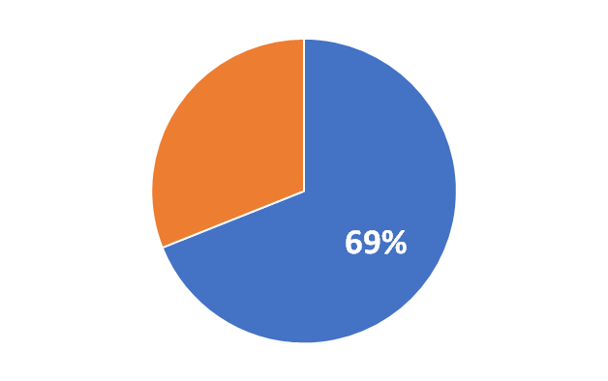
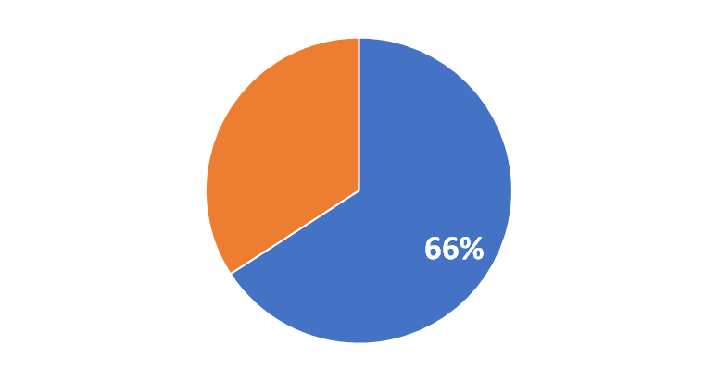

Results for considering Neutral tweets as Negative
Custom Analyzer Precision
TextBlob Precision
Srinivas Pakala

Slide 36
#MeToo Tweets analysis
Data: Tweets on #MeToo
Data Source: Data World
Dates range:
The tweets have been collected for 5 months from October 2017 to February 2018.
Total number of records: 393,869
Durga Charan Potukuru

Slide 37
Month-wise analysis of tweets on #MeToo
Total number of tweets - 393,869
2017
2018
Durga Charan Potukuru

Slide 38
Attributes of Tweets Object
TweetId
id
insertdate
twitterhandle
followers
hashtagsearched
Dateoftweet
text
lastcontactdate
Lasttimelinepull
lasttimetweetsanalyzed
Numberoftweetsanalysed
Numberoftweetsabouthash
actualtwitterdate
Durga Charan Potukuru

Slide 39
Results of #MeToo Analysis
Total number of tweets - 393,869
6019
112511
144611
108630
22098
Durga Charan Potukuru

Slide 40
Limitations
No access to demographic data like age of the person, location, gender etc
Expensive historic data
Cannot retrieve data from other social media
Storage of historic data
Durga Charan Potukuru

Slide 41
Acknowledgement
We thank our client Dr. Shin, our professor Dr. Bandi and other teams for their valuable time. We are grateful of your presence and your feedback motivates us to do better.

Slide 42
Thank You!

Slide 43
Sentiment analysis - Result
S. No | Text | Manual | TextBlob | ParallelDots | Aylien
1 | I love this sandwich | Positive | Positive | Positive | Positive
2 | This is an amazing place! | Positive | Positive | Positive | Positive
3 | I feel very good about these beers | Positive | Positive | Positive | Positive
4 | This is my best work | Positive | Positive | Positive | Positive
5 | What an awesome view | Positive | Positive | Positive | Positive
6 | Tomorrow is Wednesday | Neutral | Neutral | Neutral | Neutral
7 | I am tired of this stuff | Negative | Negative | Negative | Negative
8 | I can't deal with this | Negative | Negative | Negative | Negative
9 | He is my sworn enemy! | Neutral | Neutral | Negative | Positive
10 | I am here | Neutral | Neutral | Neutral | Neutral

Slide 44
Sentiment analysis API - Conclusion
Use TextBlob API
Benefits of TextBlob:
Python library (Installed as a Package)
Custom classifier
Language translation and detection
Notes:
VC

Slide 45
Supervised Learning
Data with clearly defined output is given
The training dataset is used to train the machine
Classification: Machine is trained to classify something into some class.
classifying whether a patient has disease or not
classifying whether an email is spam or not
Regression: Machine is trained to predict some value like price, weight or height.
predicting house/property price
predicting stock market price

Slide 46
Unsupervised Learning
The machine learns through observations and find structures in data
Clustering: A clustering problem is where you want to discover the inherent groupings in the data
such as grouping customers by purchasing behavior
Association: An association rule learning problem is where you want to discover rules that describe large portions of your data
such as people that buy X also tend to buy Y

Slide 47
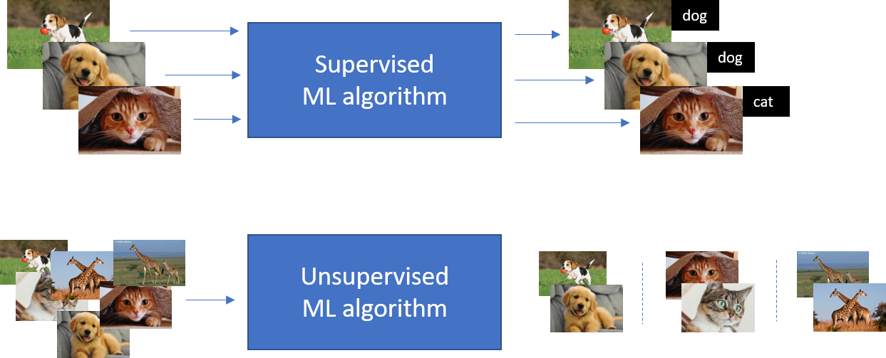
In short,

Slide 48
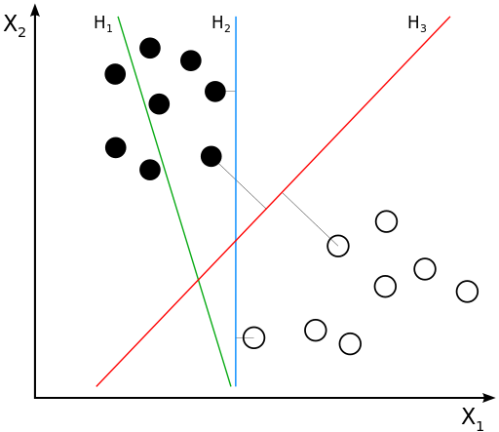
SVM
It is supervised learning associated with learning algorithms
Used for classification and regression analysis
It constructs a hyperplane
In general the larger the margin the lower the generalization error of the classifier
SVMs are helpful in text and hypertext categorization
The SVM is only directly applicable for two-class tasks

Slide 49
PCA
Eigen decomposition - Computing Eigenvectors and Eigenvalues
Covariance Matrix/ Correlation Matrix/ Singular Vector Decomposition
Obtain Eigenvectors and Eigenvalues
Selecting Principal Components
Sort the (eigenvalue, eigenvector) tuples from high to low
Calculate explained variance
Projection Onto the New Feature Space

Slide 50
